Slide 1
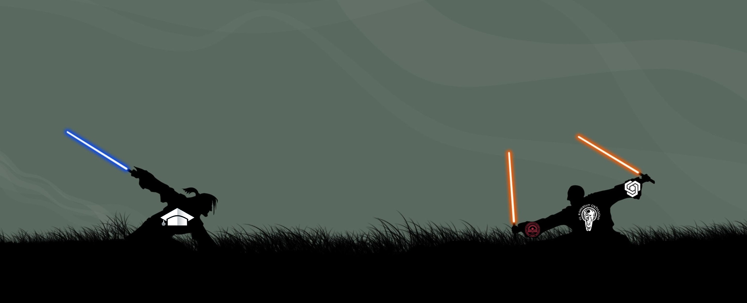

“University Wars”
1
Team “BOUVARDIA”

Slide 2
Team Members
2
Radostin Avramov
Username: turboto5
Boni Mislyashki
Username: Shade
Iliya Iliev
Username: bsdemon
Zhan Ivanov
Username: Shade

Slide 3

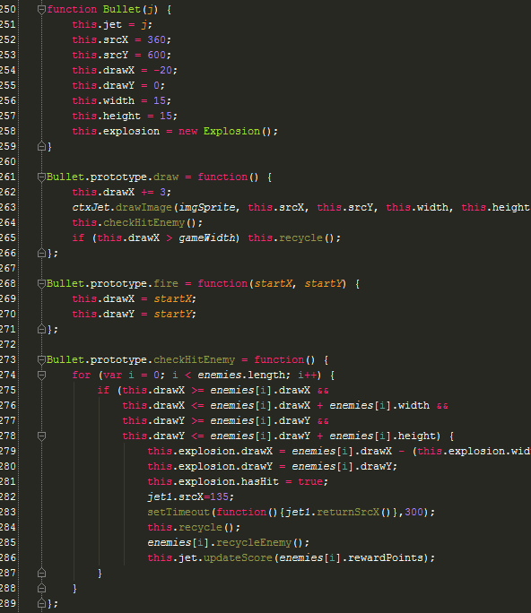
Brief code description
3

Slide 4
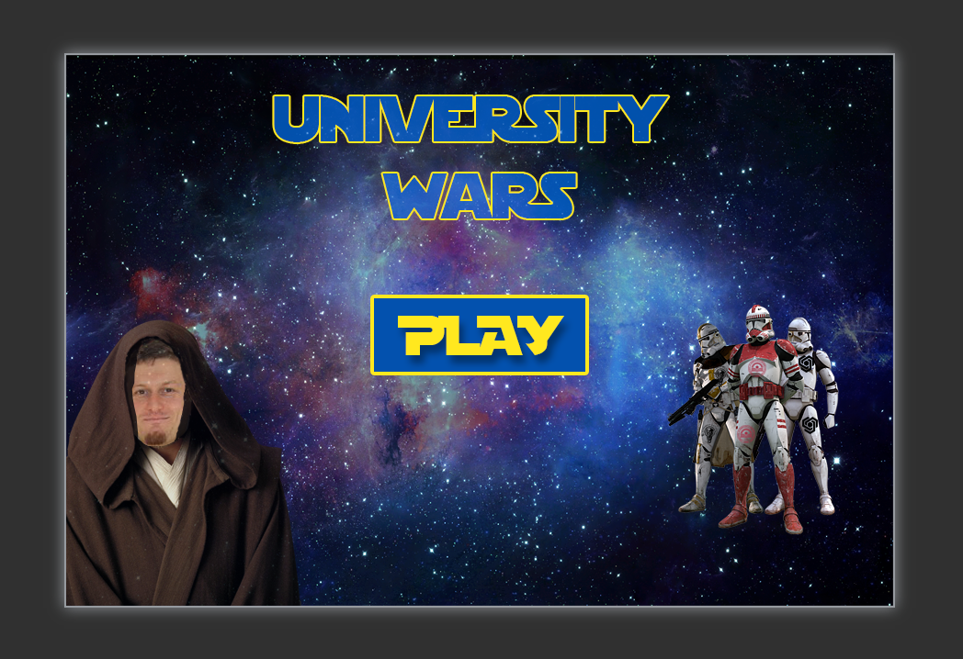
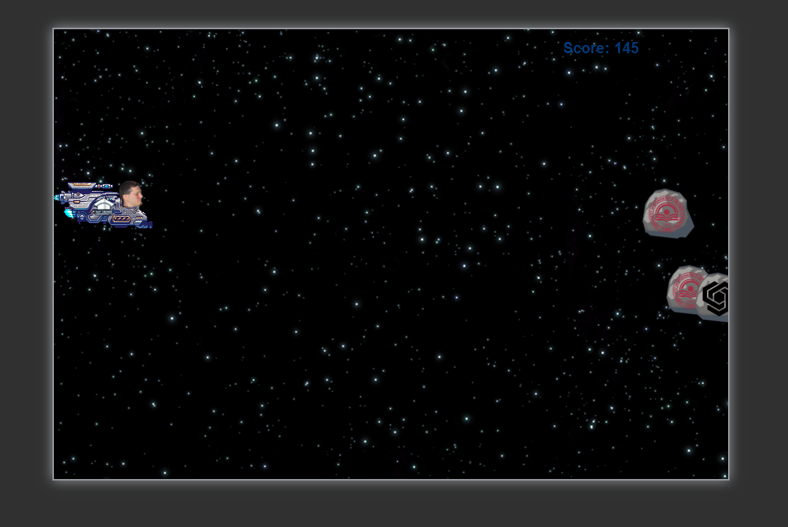
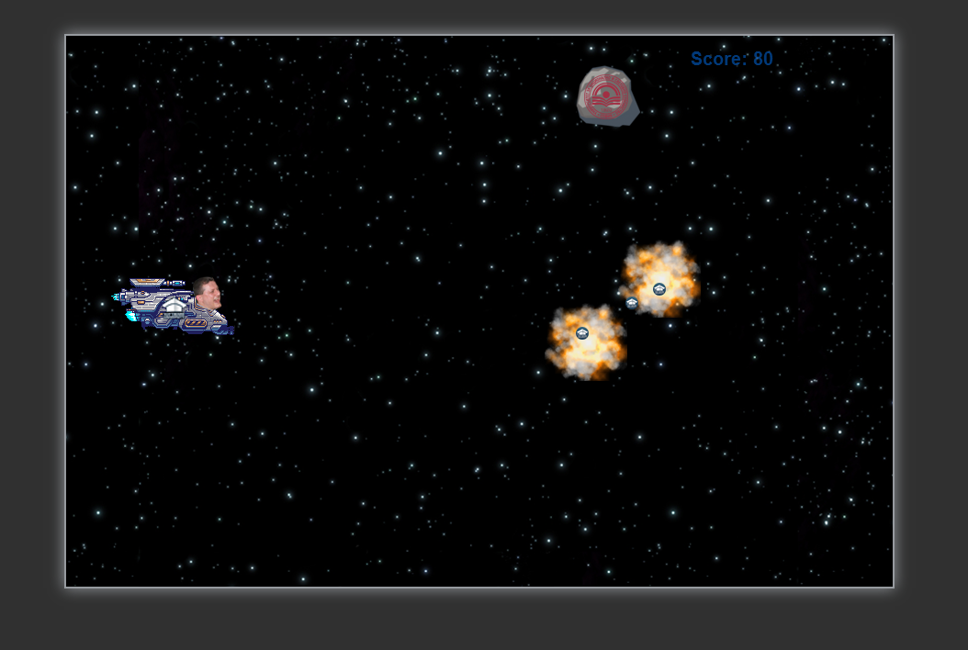
Game Demo
4

Slide 5

Thank you for your attention
5

